Slide 1
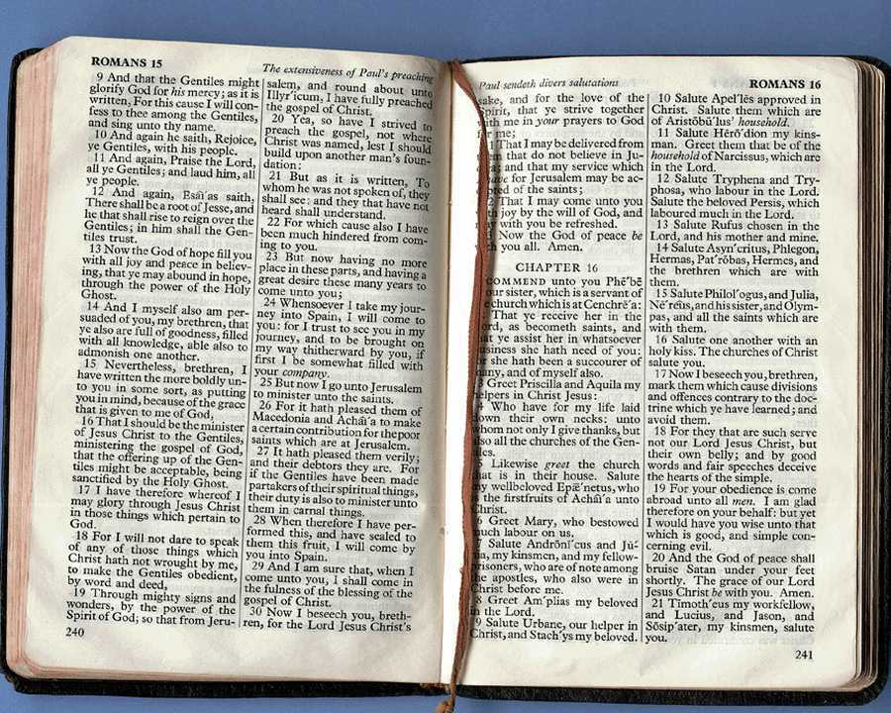
Kawicham dinbo pathak pajai: Pathak pajai Din maraa padbo kawicham paoronra
Dr. Rick Griffith, Singapore Bible College
BibleStudyDownloads.org
Notes:
Welcome & thanks

Slide 2
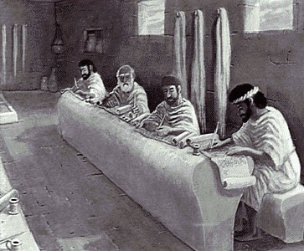
Ndekam khatdi ndekambije paguwad pakhiangna

Slide 3
“Aliu chabin tadne wibo haptap ga."
Nde tiu jiu aliu tadra?
Gari kasiam ga niu?
Gari katheng ga niu?
Gari kadi ga niu?
Kalinbung ga niu?
Gari pangin sum ga niu?
Chaphi ga niu?
Aliu ndelam tad ralo chiubo sai sui jiu !

Slide 4
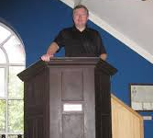
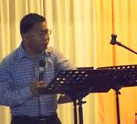
“Aliu niu din maraa padbo tacham din"
Chiudi Haise ra?
Din masan khaibo ariak?
Kam alumkhaibo?
Masan ariak chamlam ?
Kamkanibo?
Mathiu niu sui bo paramba.

Slide 5
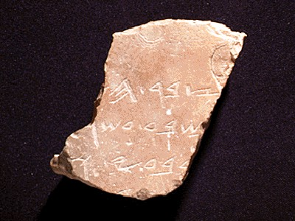
Nde niu tacham se pawad pakhiang si khai?
1
“Pawad pakhiang ne laddin bo se din masan jiu pariang chiu chamai ram mai tu maji bo khatdi takhai thinpiu suibo ladriang dung"
Paramba
Walter Liefeld, NT Exposition, 6
Notes:
04.03

Slide 6
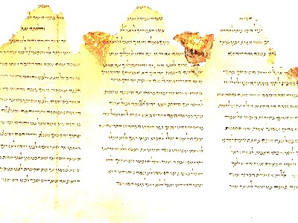
Kaisan lan bo paramba…
1
“Pawad pakhiang na dinronbo masanbo racham wangbo se khatdi padbose characham, chalad kamje, ariak khuang gu pariang khatdi pajai ali, Huipuina niu wang rai jiu pumtan pikhai, chiu pakhu gasu kamkhai mibo gu chamai " (Robinson, 20, lupad paniu kawicham laddin )

Slide 7
Din maraa padbo pajai
1
Masanbo charou ga para kathiubo se din khai lo
Liefeld, 6-7
Notes:
E.g., 1 Cor 13:1-7
Reference to other Scriptures is subordinate to the exposition of the main passage

Slide 8
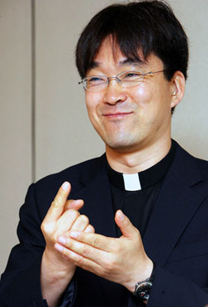
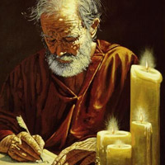
Din maraa padbo pajai
1
Ariak roukhai bopiu gu chunning ga kam khai bo
=
Liefeld, 6-7
Notes:
Neh 8:8
Luke 4:16-22 on Isa. 61:1-2
The text is not a box of candy from which one selects his favorite treats. It is the Word of God, which has come to us to be master, not servant.
For example, preaching leadership principles from Nehemiah 1—2 misreads authorial intent.
You can preach a biblical message from the wrong verse!
In other words, you can be held by a great theology so that you preach truth, but it may not be the message of the particular passage before you.

Slide 9
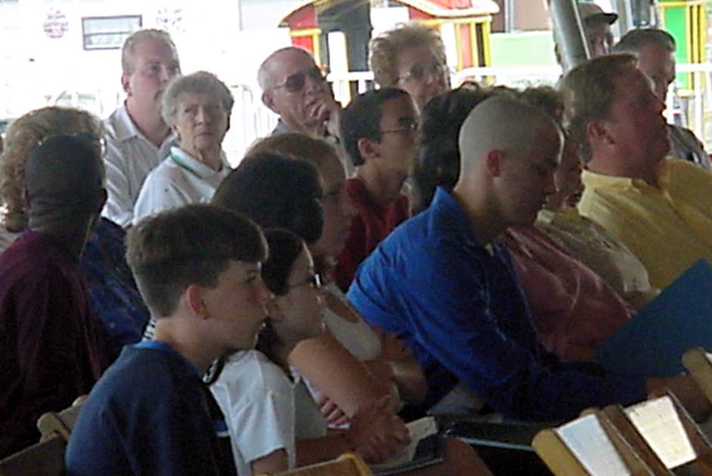
Din maraa padbo pajai
1
Nchambo
Makum dibo
Makum ariak khuang
Liefeld, 6-7
Notes:
True exposition expounds the one, central idea of the text called the Big Idea (homiletical idea or main idea or synthetic statement). Real exposition is not a series of exegetical comments, unrelated truths, or a cute outline that gives a survey of a passage

Slide 10
Din maraa padbo pajai
1
Malaibo khatdi Lenkhaibo
I. Alam-e makum dibo tu
II. Alam-e makum dibo tu
III. Alam-e makum dibo
Makum dibo chiudin
Makum ariak khuang
Liefeld, 6-7
Notes:
brings the hearers towards the same point made by the author. The message does not simply state the main idea over and over without some design that brings the listeners along in truth

Slide 11
Din maraa padbo pajai
1
Aleng lukhaibo
Nking mainiu nde gu…
Sira
Niatoubo sibo
Kamra
Makum ariak khuang
Liefeld, 6-7
Notes:
It relates biblical truth to the listener's life in line with the original purpose, meaning, or function of the text.
Application must first be applied to the preacher's life to be effective exposition
----- Meeting Notes (7/5/12 10:55) -----
Preaching without application is like making a car but forgetting to put the tyres on! It is "where the rubber meets the road" in this sense, for the sermon will go nowhere without application.

Slide 12
Pajai Pathak khai aruangwangbo
1
Notes:
Summary: So then, what is expository preaching and what is it not?

Slide 13
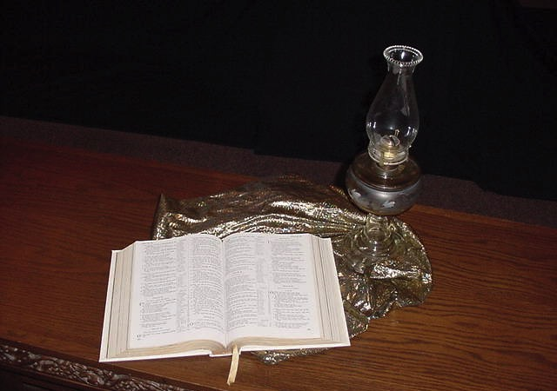
Nde kam ja Kawi cham din maraa padbo se wijiulo?
2

Slide 14
A. Din maraa padbo se kamajibo ariak siniu len khai bo se Tingwang chun ye
2
Narunna chara tu kahumbo ringting
Naki lunga
Nangam kam bo ga
Kawi cham ken bo ga
Notes:
The more we preach from Scripture, the less false teaching we will have.
We have only ONE inerrant book! Why preach other things?

Slide 15
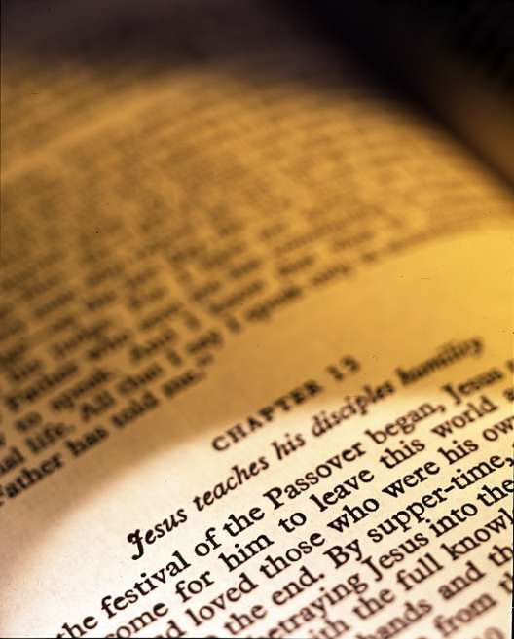
B. Din maraa pad bose Tingwang ladkeng katikhaibo se pawanjeng se Huipuina masan niu ye.
2
Akhe khaibo kasatu “tamsinjiu kam bo"
Akhe khaibo kasatu majikamak “ Kamasiakbo tu ari arabo"
Notes:
God's Word is much more effective than the best of man's sermons to affect people's will and meet their needs.
"The type of preaching that best carries the force of divine authority is expository preaching" (Robinson, 19).

Slide 16
C. Din maraa padbo se moumakbo chamtan khatdi pumtan
2
Notes:
Isaiah 55:10-11
----- Meeting Notes (7/5/12 11:23) -----
As water comes from God and blesses the earth, so God's Word comes from him and blesses his people.

Slide 17
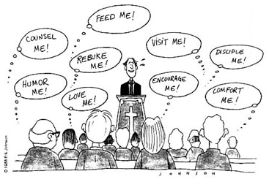
Nang ndetiuja hanchali ralo haibo meng?
Pi tiu khai atu!
Ladti khai atu!
Wang khai akhu!
Kasan khai atu!
Majang khai atu!
Kamnui khai atu!
Kathot khai atu!
Lungsa khai atu!
Kam aman khai atu!
Notes:
Any kind of preaching is tough today!
Yet it still has inherent authority and power when it preaches God’s Word!

Slide 18
D. Din maraa padbo se lenkhaija maring khaibo nking mai Masanbo lakeng
2
Chaphai tani
Nsun tetiu
Ngena
Notes:
By teaching his people how to get answers from Scripture itself, the pastor frees himself up from always being the authority.
Expository sermons remind people that the final authority is the Bible—not the preacher!

Slide 19
Ndekam bija Tingwang ladkeng se para thiu jiu lo?
Masanbo araik hinase Tingwang niu pikhaibo-e, khatdi pageng bambo-e, haise katikhaira, kamaobotu rukhaira, majimakbo situ kam maji khaira khatdi majijiu lung lura katikhai raleng-e.
Sichiujiu Tingwang ngam kambo mainiu wasimasan lujiu khatdi kawibo ngam hina kamlu raleng-e
2 Timothy 3:16-17 (NIV)

Slide 20
Madai kapadbo Tingwang ladkeng
2
Translate text under this black shape
Rukhaibo
Kammajikhaibo
Katikhaibo
Katikhairaleng (Majijiu lungra)
2 Timothy 3:16-17
Notes:
If you preach sequentially through the Bible, you will have the divine balance in these four areas:
Teaching tells people how to walk God's road
Rebuking tells them when they get off the path
Correcting shows how to get back to the right way
Training in righteousness is the result of the cycle of teaching, rebuking and correcting over and over.

Slide 21
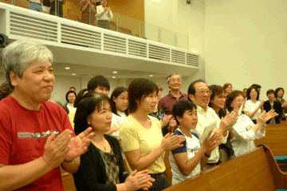
E. Din maraa padbo se chamai gu nchangbo luni se huipuinaga muikhang bo-e
2
Notes:
Good expository preaching does not impress the congregation; it feeds them.

Slide 22
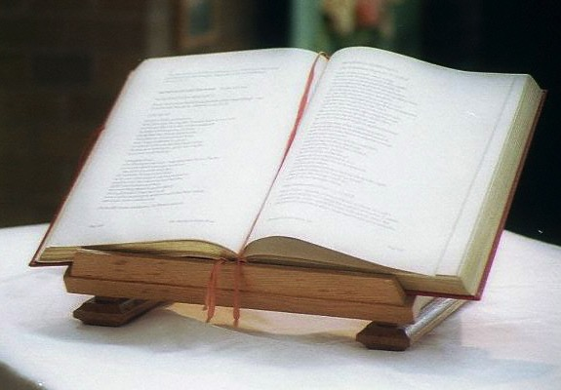
F. Din maraa padbo se kham khai-e dinmoakhaibo masanbo ariaktu
2
Wanjeng
Wanjeng
ariak
wanjeng
Wanjeng
Notes:
"Spiritualizing" (drawing a spiritual lesson while ignoring the actual meaning of a passage) is more difficult to fall into when one preaches from a single text than when the pulpit hits at verses all over the Bible.

Slide 23
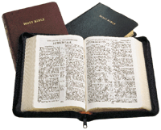
G. Din maraa padbo se ladin pakhiang kawicham din boniu wi-e
2
2025 Tacham
2023 Tacham
Hapta 1
Hapta 4
Hapta 2
Hapta 5
2017 Tacham
Hapta 3
Hapta 6
2009 Tacham
Din maraa pad
Dinthubo kawicham paorun
2021 Tacham
2022 Tacham
Galatiamai
Galatiamai
2020 Tacham
2018 Tacham
Hapta 7
Hapta 10
2026 Tacham
2024 Tacham
Hapta 8
Hapta 11
Hapta 9
Hapta 12
Notes:
In a 10 year period, topical preaching might at best hit a third of the text in these two pages.
Systematic exposition has an advantage in that it enables listeners to see the big picture of each biblical book and cover every passage.

Slide 24
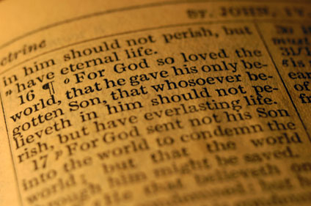
H. Din maraa padbo se pawan kam maha mak ge nde gu din ralo chiu maning bam mak
2
“Tingwang, nde lad din ra haibo hapta?"
Notes:
It is good to wait upon God. But how sad to be switching topics as you study through the week as you wait on God to show you what to say. How much better to wait on Him to reveal the passage you are committed to preach. Then the text is master and you are the slave, obedient to it dictates.

Slide 25
I. Din maraa padbo haise kawichampiu pagu malum gasu npoubo
2
Pipadbo
kabuabo
Akhang aliu thiumak masan
Notes:
Who likes to preach on relational problems? Who would volunteer to preach on sex? Most pastors shy away from talking about giving, fearing that some might think they want a raise. Yet in sequential exposition, these important topics come up naturally in the course of preaching through a book of Scripture. No one can accuse the speaker of meddling in their lives as this is what the text shows.

Slide 26
J. Din maraa padbo se aliu tu kham khaibo mai khu kasabo kalang lad kawicham din ron
2
Nde gu kasa?

Slide 27
Kasia kasabo kalang lad kawicham dinron
2
Kalang lad kawicham din ron | Din maraa kawicham dinron
Kawicham din nia maksai keng din masan bo ariak | Pabam khat tu para thiujiu dinbo
Mala jiu kada lubo laddinpiu niu din nibo kawicham ariak gasu | Tingwang niu nde din khai ni lo chiubo ariak rou piu nai
Laddinbopiu niu chunrang thiu jiu pagu padon kam | Laddinpiu gu ladriang se ariak khuang ga dou bo
Pawan se wang tang lak mirabo ariak ram mai gu wanjeng simak sai | Pawan se tang-e ariak ram mai pagu wanjeng tu aruang sui-e
Laddinpiu tu mainiu majimak ge chiujiu din sui maitu npou bo ga | Laddinpiu maniu kam kabuak mak ge, mainiu din mui pajai ga din khai.

Slide 28
Black

Slide 29
Kawicham din (Kawicham din ron bo Pathak khatdi pajai) link at BibleStudyDownloads.org
Paman thiu mak jiu hai se ngou lune!
Notes:
Preaching (pr)
Homiletics

